Slide 1
Risk Reduction at Ash Disposal Area No. 2
A Case Study
TVA Johnsonville Fossil Plant
New Johnsonville, Humphreys County, Tennessee
Presented By
Roberto L. Sanchez, PE and Stephen H. Bickel, PE

Slide 2

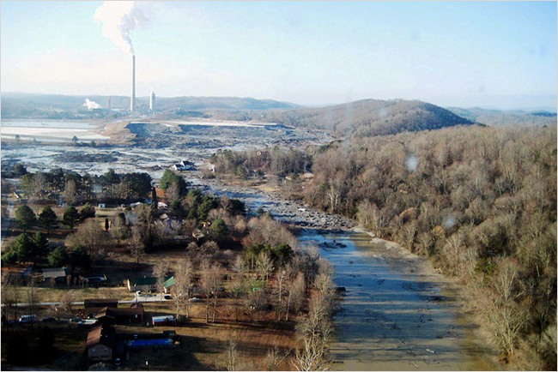
In the beginning ….
Soon after the December 2008 dredge cell failure at its Kingston, TN fossil-power generating facility, TVA created an internal project management organization named Fossil Generation Development & Construction (FGD&C) to address potential geotechnical instability issues at all of its other plants’ Coal Combustion Products (CCP) storage facilities.

Slide 3
TVA’s Eleven Fossil Plants
Shawnee
10 Units 1750 MW
U10 idled
Paradise
3 Units 2558 MW
John Sevier
4 Units 800 MW
Bull Run
1 Unit 950 MW
Cumberland
2 Units 2600 MW;
Virginia
Tennessee
Johnsonville
10 Units 1485 MW
Gallatin
4 Units 1255 MW
Kingston
9 Units 1700 MW
North Carolina
Allen
3 Units 990 MW
Georgia
Colbert
5 Units 1350 MW
Widows Creek
8 Units 1969 MW
Mississippi
Alabama

Slide 4

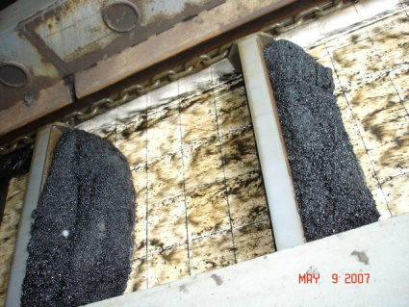
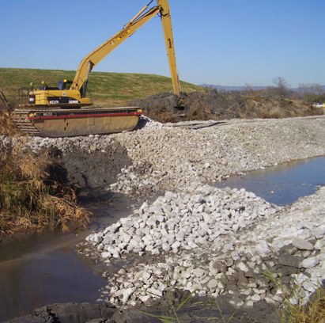
FGD&C’s Programmatic Mission
Dry
Storage
Close all Wet Storage Facilities
Convert Wet CCP Processes to Dry Operation
(Fly Ash, Bottom Ash, and Gypsum)
Develop a Water Management Strategy for Plant Process Water
Implement Long Term Stability Improvements and Remediation to Existing CCP Facilities

Slide 5
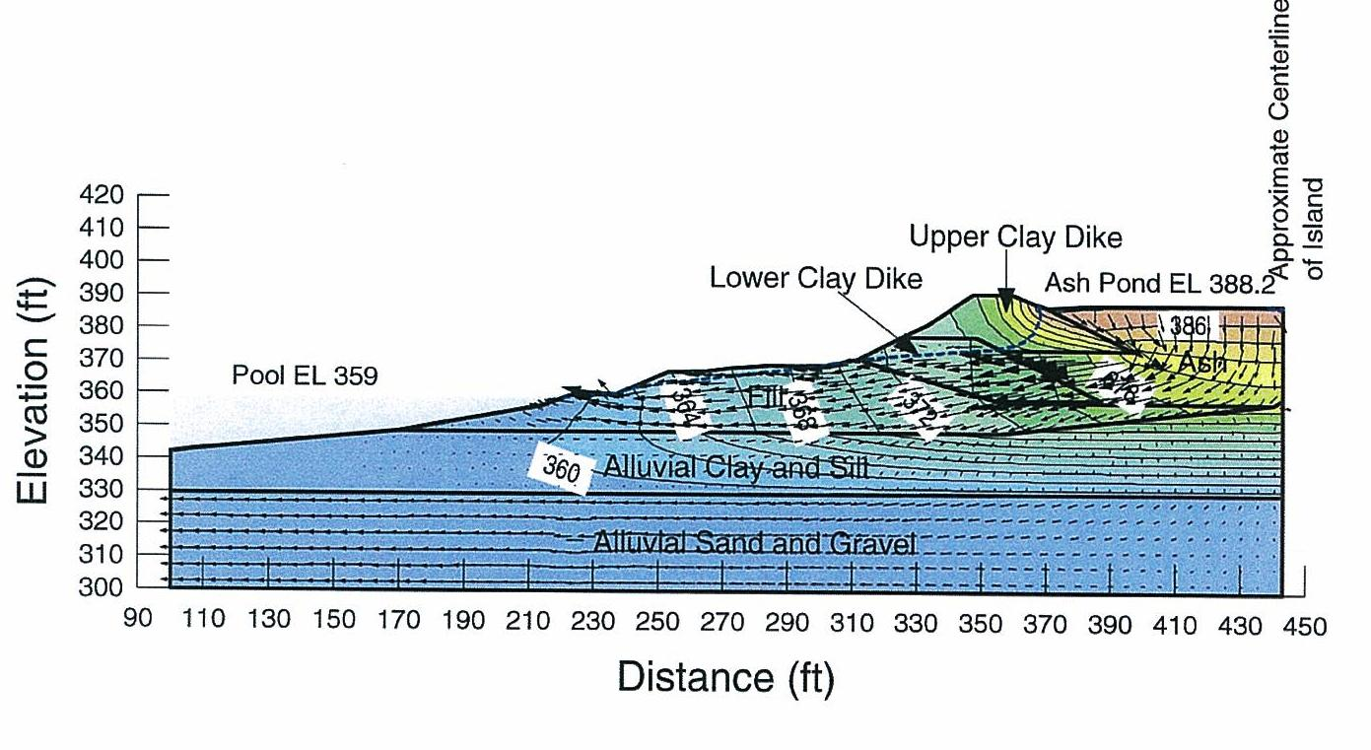
FGD&C’s Highlights
  Phase 1 – Facility Review
    Records Review/Staff Interviews
    Site Condition Review
    Recommendations for Future Analysis, Studies, and Program Improvements
    Final Report Issued June 24, 2009
  Phase 2 – Engineering Assessments
    Geotechnical Explorations
    Hydrologic and Hydraulic Analysis
    Dam Safety Hazard Classifications
    Spillway Inventories
  Program Goals
    Assess Structural Conditions of Impoundments
    Implement Improvements
  Program Statistics
    FY10 Man-hours ~ 472,324
    FY 09 Engineering Man-hours ~ 168,074
    Borings ~781 (47,000 ft of footage drilled)
    Instruments ~ 594
    Rock Placed ~ 455,305 tons
    Sand ~ 26,277 tons
  Phases 1,2,3 and 4 in Parallel

Slide 6
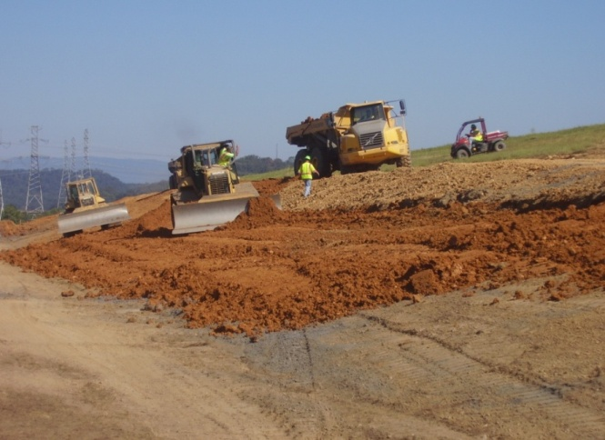

CCP Projects & Engineering’s Highlights
  Phase 3 – Remediation Design and Construction
    Structural Deficiencies
    Improve Freeboard (Storage)
    Risk Reduction
  Phase 4 – Programmatic Improvements
    Dam Safety Inspection Training
    Programmatic Documents
Construction of Improvements at Bull Run

Slide 7
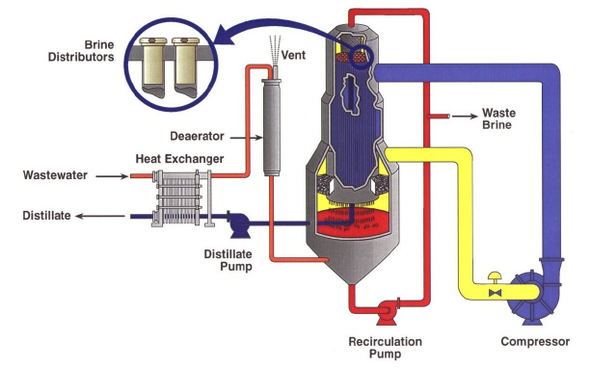
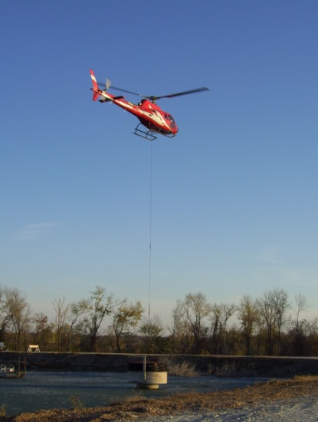
Looking Forward – FGD&C’s Next Steps
Closure of all CCP Impoundments
Transition to Dry Storage.
Build Landfills
Construct Dewatering Facilities.
Implement Waste-Water and Storm-Water Management Strategies.
Evaluate Seismic Risks.

Slide 8
Results of the Phase 1 Assessments
The Phase 1 Assessment performed for Ash Disposal Area No. 2 at TVA’s Johnsonville plant resulted in a high priority ranking with regards to needed risk reduction actions. The assessment uncovered the following issues of concern:
  A lack of adequate hydraulic freeboard;
  Seepage areas which had reportedly increased in size;
  Tall spillway risers that were leaning;
  Submerged spillway outlet pipes that regularly surged and had a history of sinkhole formations; and
  Steep exterior dike slopes with potentially low factors of safety.

Slide 9
Presentation Outline
This presentation describes the Risk Reduction Program performed for JOF’s Ash Disposal Area No. 2. This facility was placed on a high priority list due to its environmentally sensitive location.
The presentation is divided in the following sections:
  Plant location and history;
  Ash Disposal No. 2 construction sequence;
  Results of Phase I Assessment;
  Risk Reduction Program; and
  Summary and Conclusions.

Slide 10
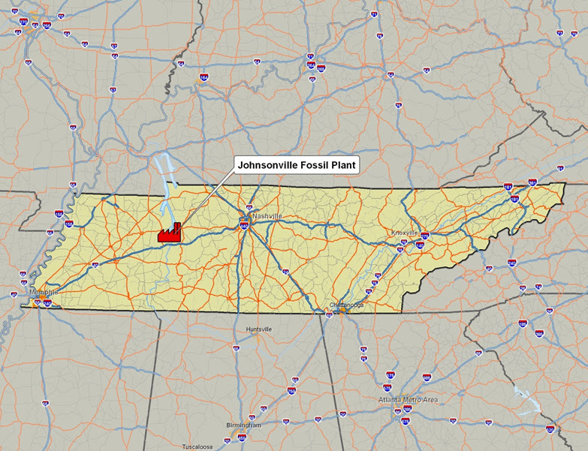
Johnsonville Fossil Plant
General Vicinity Map
Notes:
Location is in west-central Tennessee - about 65 miles west of Nashville – one third the distance between Nashville and Memphis

Slide 11
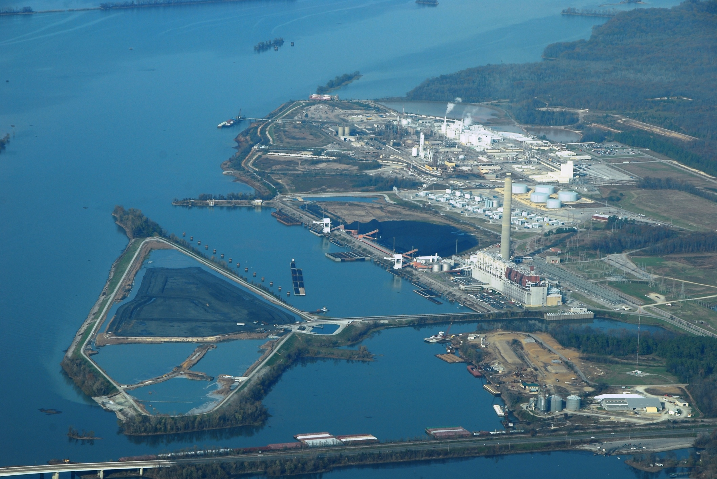
Johnsonville Fossil Plant
Aerial View
Powerhouse
Kentucky Lake
Ash Disposal Area 2
Notes:
Areal view showing the plant and Ash Disposal Area 2 surrounded by water.

Slide 12
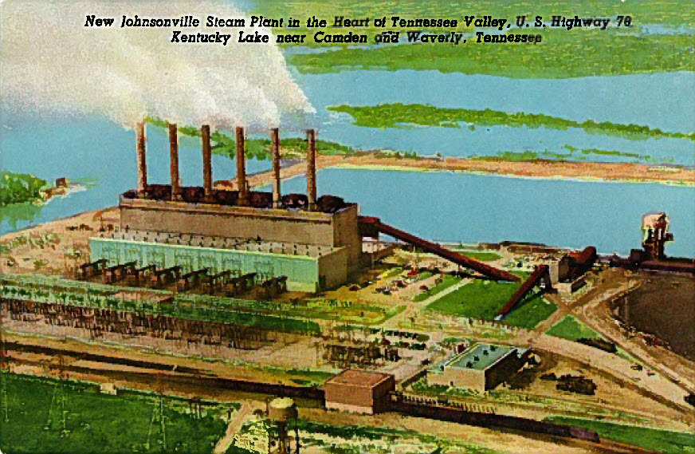
Johnsonville Fossil Plant
Postcard Circa 1955
Notes:
Just an interesting old post card found on e-bay. JOF is the second steam-electric project by TVA, currently the oldest in system. At completion it was one of the ten largest plants in the world.

Slide 13
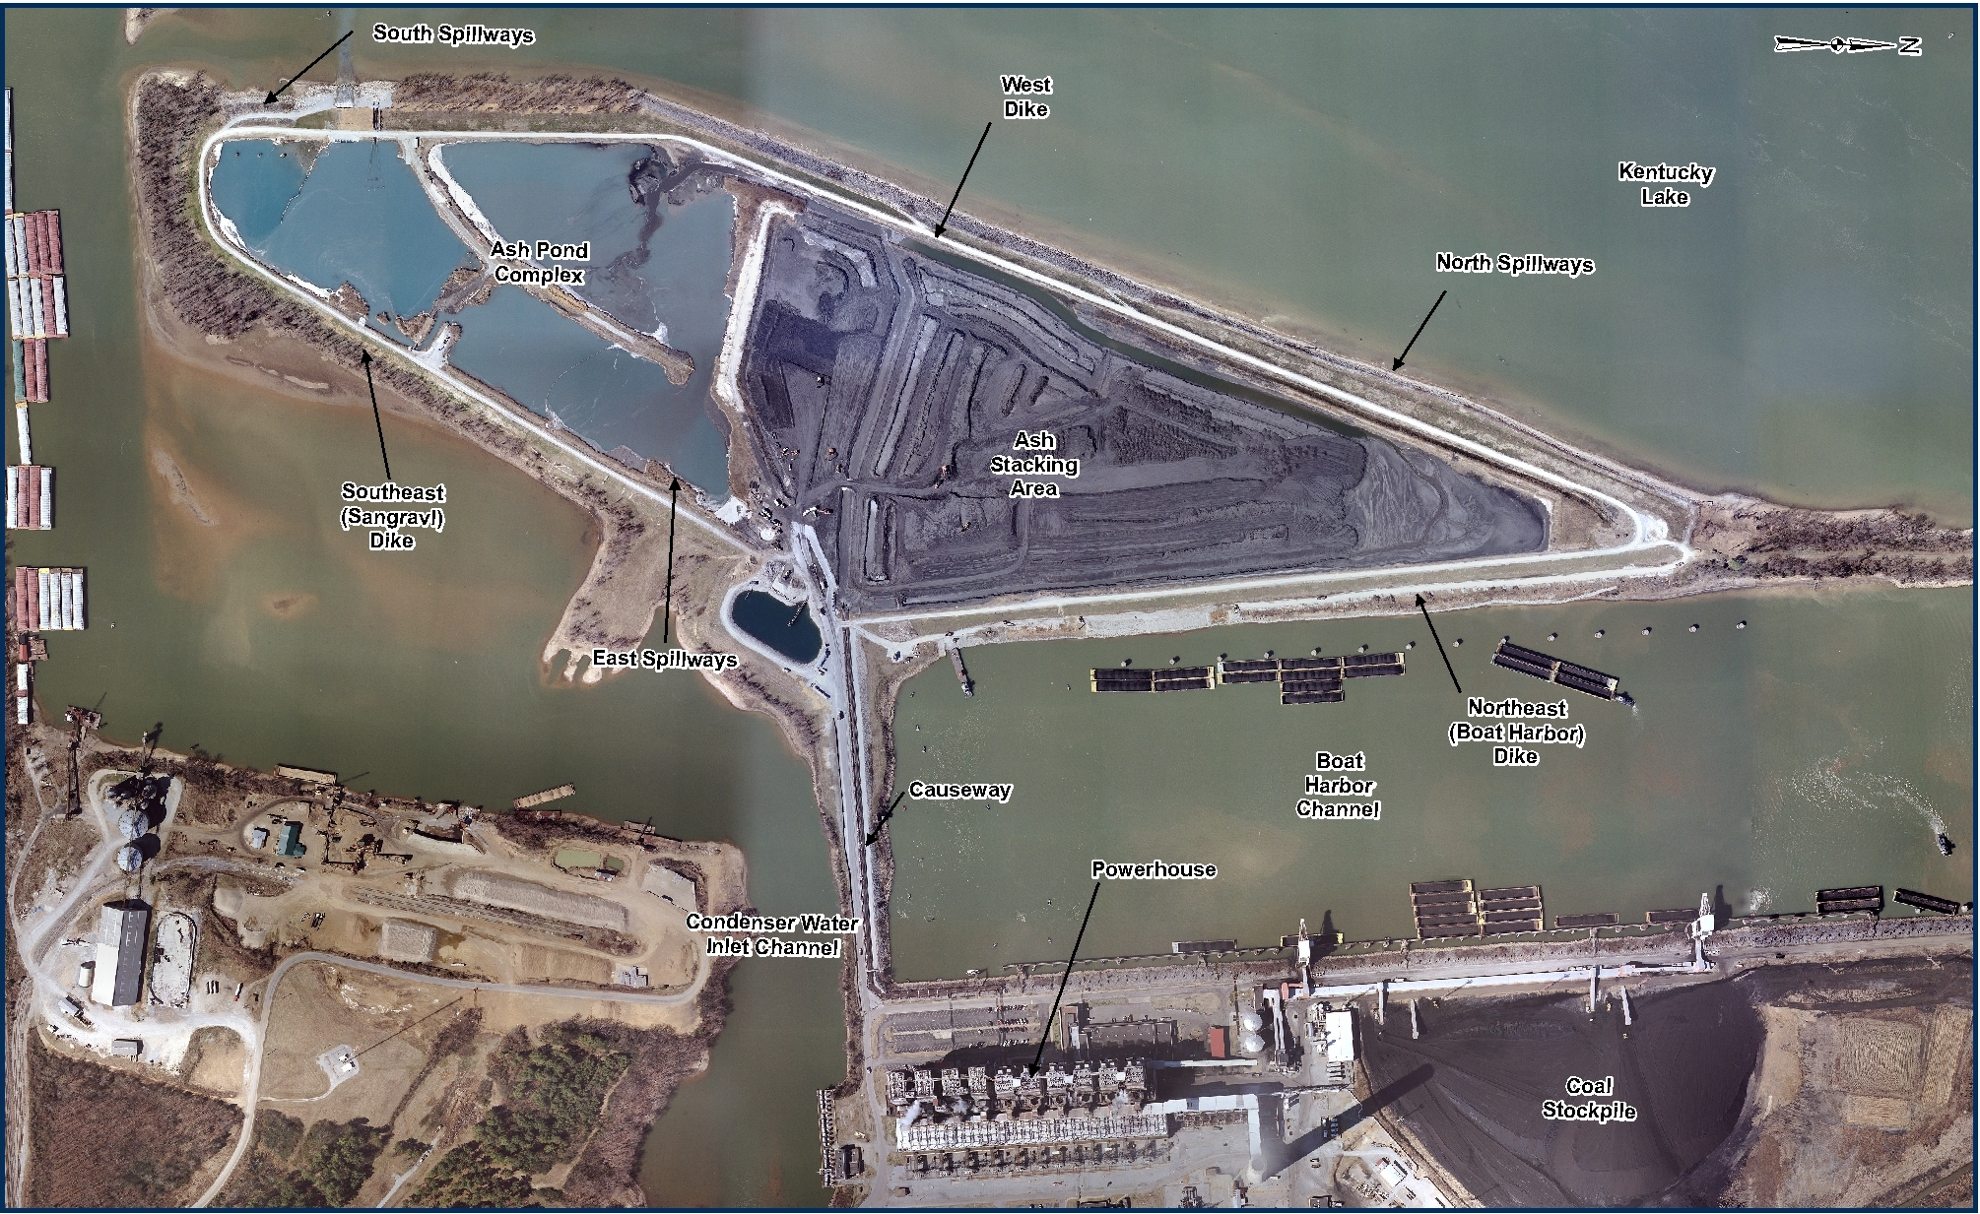

Johnsonville Fossil Plant
Site Layout for Ash Disposal Area No. 2
previous flow direction
present flow direction
Notes:
Island is 125 acres/87 within the dikes. Note ash stacking and storage on North end (mostly dry) separated by sluice channels in the middle, and the ash pond complex on the south end. Three sets of old spillways. Describe water flow.

Slide 14
  Johnsonville Fossil Plant
  Timeline for Ash Disposal Area No. 2
1949-1952 JOF Steam Plant Built. Boat Harbor (NE) & Condenser Channel (SE) Dikes built using hydraulic fill.
Mid 1960’s – Ash Disposal Area 1 reaching capacity & planning for Area 2 takes place.
1977 to 1978 – Ash Disposal Area 2 raised to Elev. 390, East spillway and Metal Waste Pond added.
1969 to 1970– Ash Disposal Area 2 built to Elev. 378. Hydraulic fill used in lower portions of West dike. North & South Spillways only.
During 1950’s to late 1960’s all ash sluiced north to Ash Disposal Area 1
1994 – Sink hole forms over one South Spillway, pipes slip lined, and middle spillway removed from service.
1994 to 1996 – Serious erosion at toe of West Dikes. Repairs w/ rip rap.
2009 Phase 1 Report, Phase 2 Geotech Study, New Spillways Designed & Installed
2002 – Slough on NE Dike forms, repairs w/ rip rap. Inspection reports that Seep 3A had increased in size.
1976 – Seepage Reported on NE Dike. Area repaired by excavating and replacing with clay. Seepage reappears later as ash pond raised.
Notes:
Just run through timeline.

Slide 15
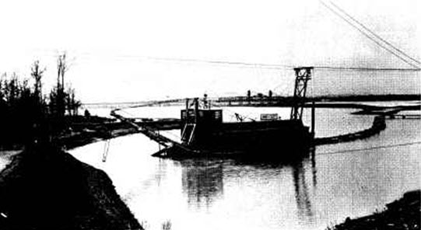
Johnsonville Fossil Plant Construction
Dredging the Condenser Intake Channel
Notes:
Dikes constructed in 3 stages. First during 1948-1950. Dredge used to place hydraulic fill in boat harbor (Northeast) and condenser water channel (Southeast) dikes during original construction. Second stage in 1968 – 1970, third in 1978.

Slide 16
Johnsonville Ash Disposal Area 2
Phase 1 & Geotechnical Studies
  Phase I Facility Assessment Recommendations
    Monitor Seep 3A
    replace spillways,
    increase freeboard, and
    perform geotechnical study
  Geotechnical Study
    Began March, 2009, Final Report March, 2010
    Forty-eight borings drilled, sixty-eight existing boring logs reviewed
    Fourteen Cross-Sections investigated, eight analyzed
    Seepage & slope stability analyses using SEEP/W & SLOPE/W
    Recommended slope stability improvements to NE & SE Dikes

Slide 17
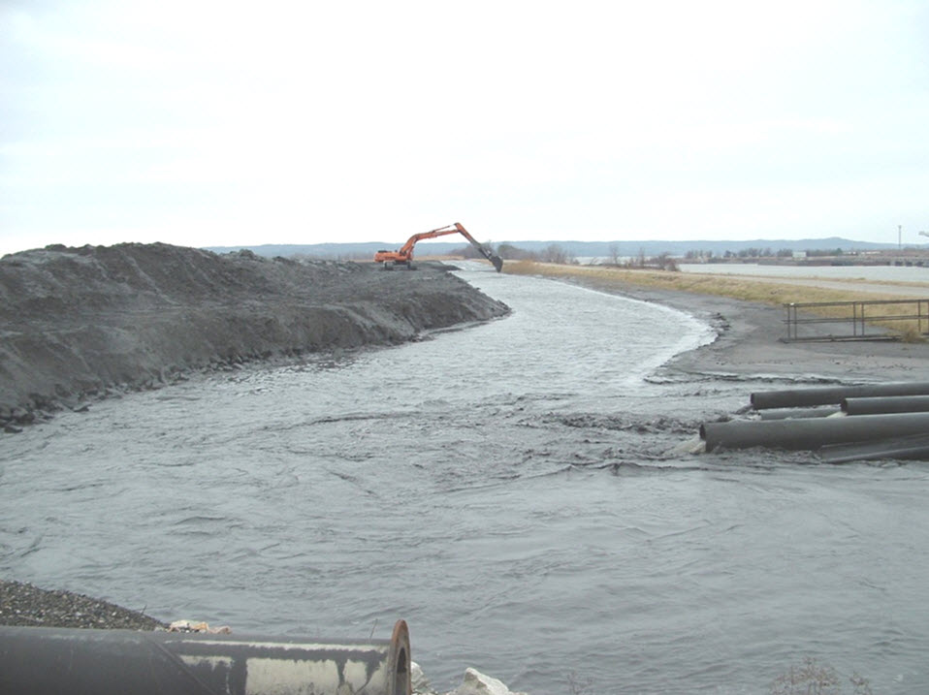
Minimum Freeboard
Sluice Channel at Northwest Dike
Approximately one foot freeboard

Slide 18
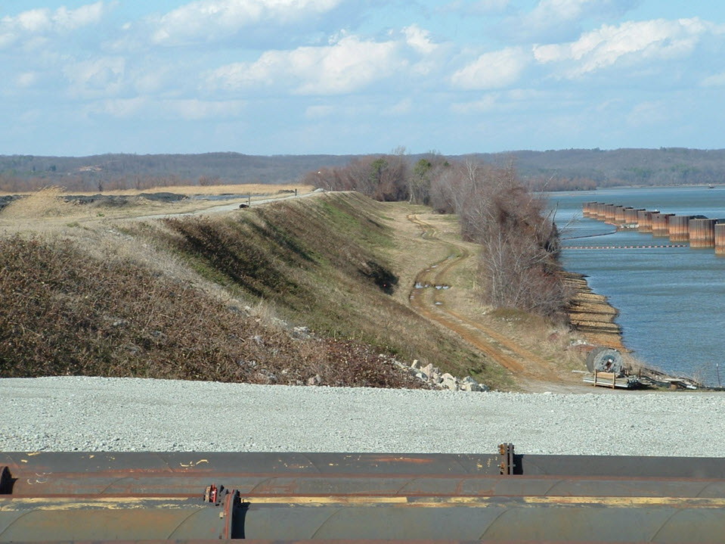
Steep/Irregular Slopes and Trees on Northeast Dike
Notes:
Original view of NE Dike during Phase 1.

Slide 19
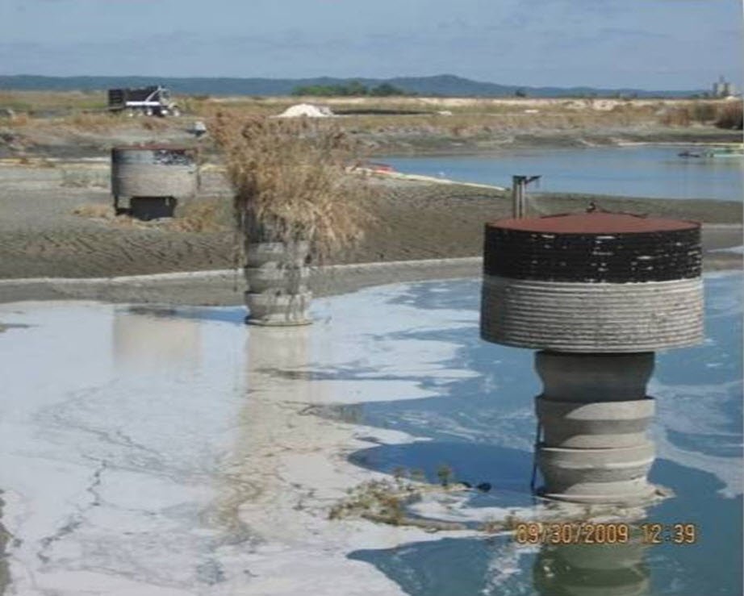
Spillway Risers in Ash Stilling Pond
Notes:
Existing spillway risers, 35 feet tall, slight tilt. Note middle riser has been inactive since 1990’s because it could not be slip-lined after the sinkhole formed on the dike slope.

Slide 20
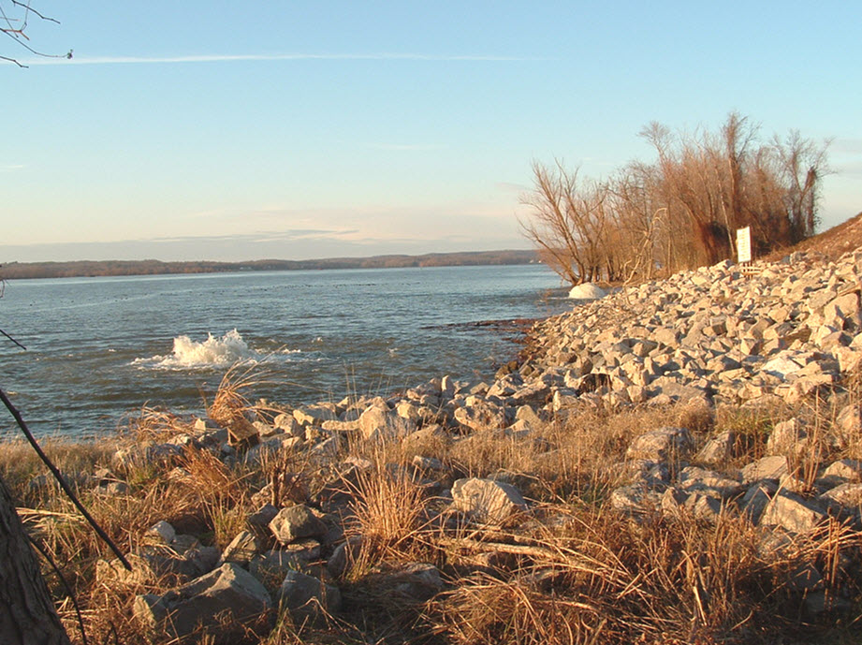
Air Surging from Spillway
Outlet Pipes
Air surging from outlet pipes
Notes:
Air surges from outlet ends of spillways, indicating pressure fluctuations within the pipes.

Slide 21
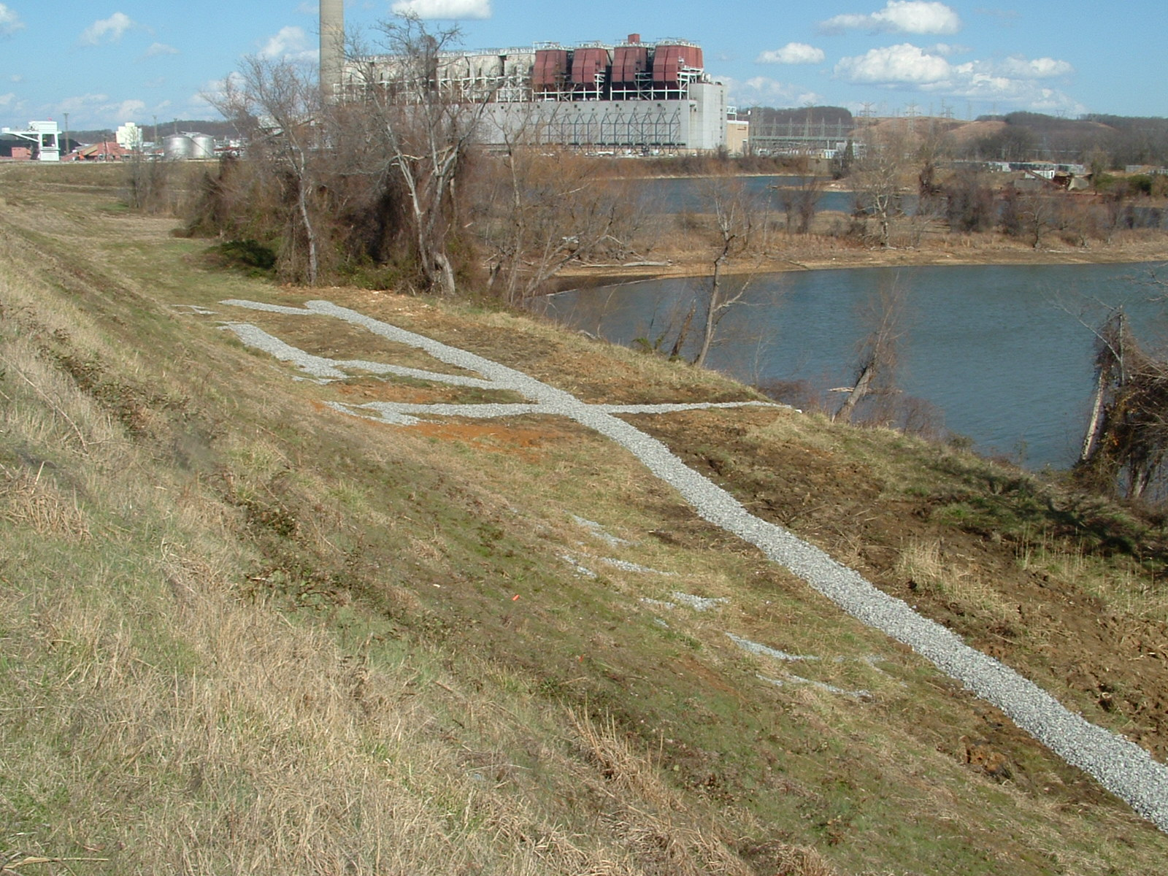
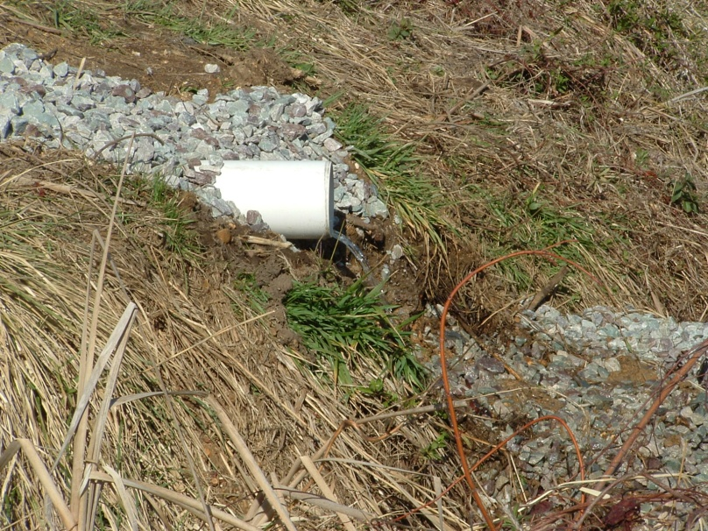
Seepage Area 3A Collection
Piping System for Monitoring
Notes:
Established dry weather base flow 3500 gpd.

Slide 22
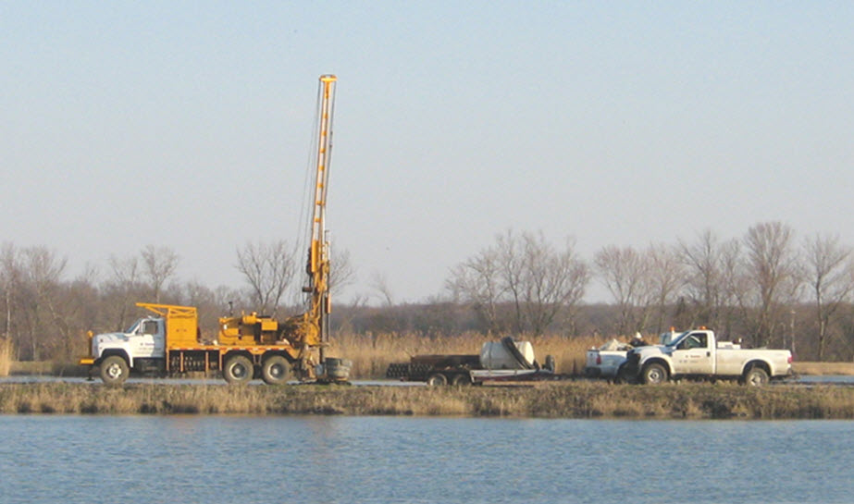
Johnsonville Facility
Geotechnical Exploration

Slide 23
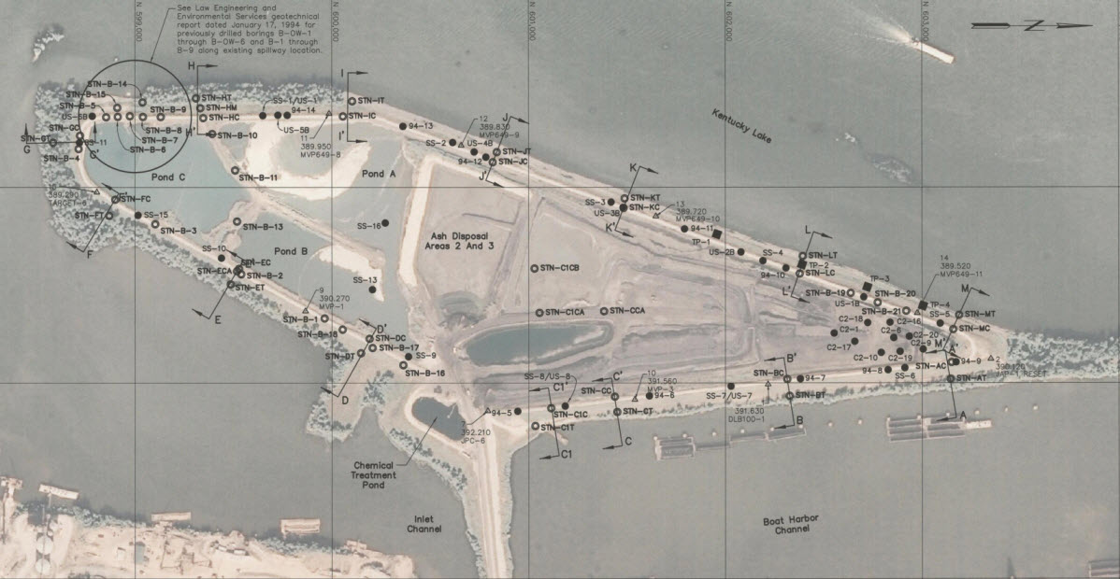
Johnsonville Facility
Geotechnical Exploration

Slide 24
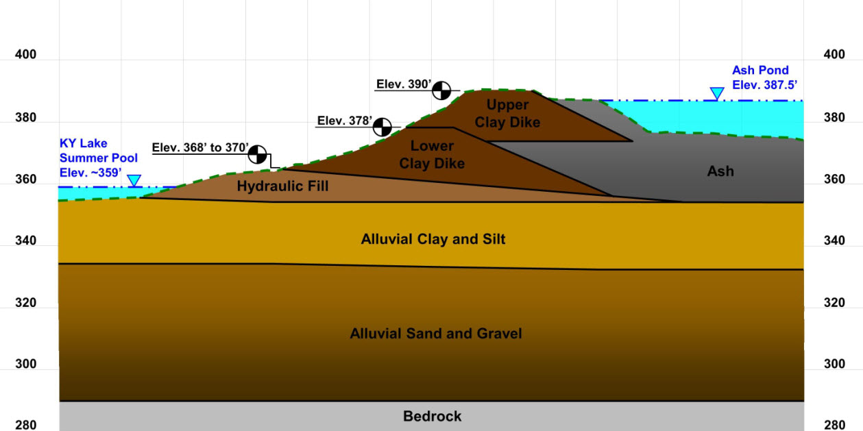
Johnsonville Facility
Generalized Dike Cross Section

Slide 25
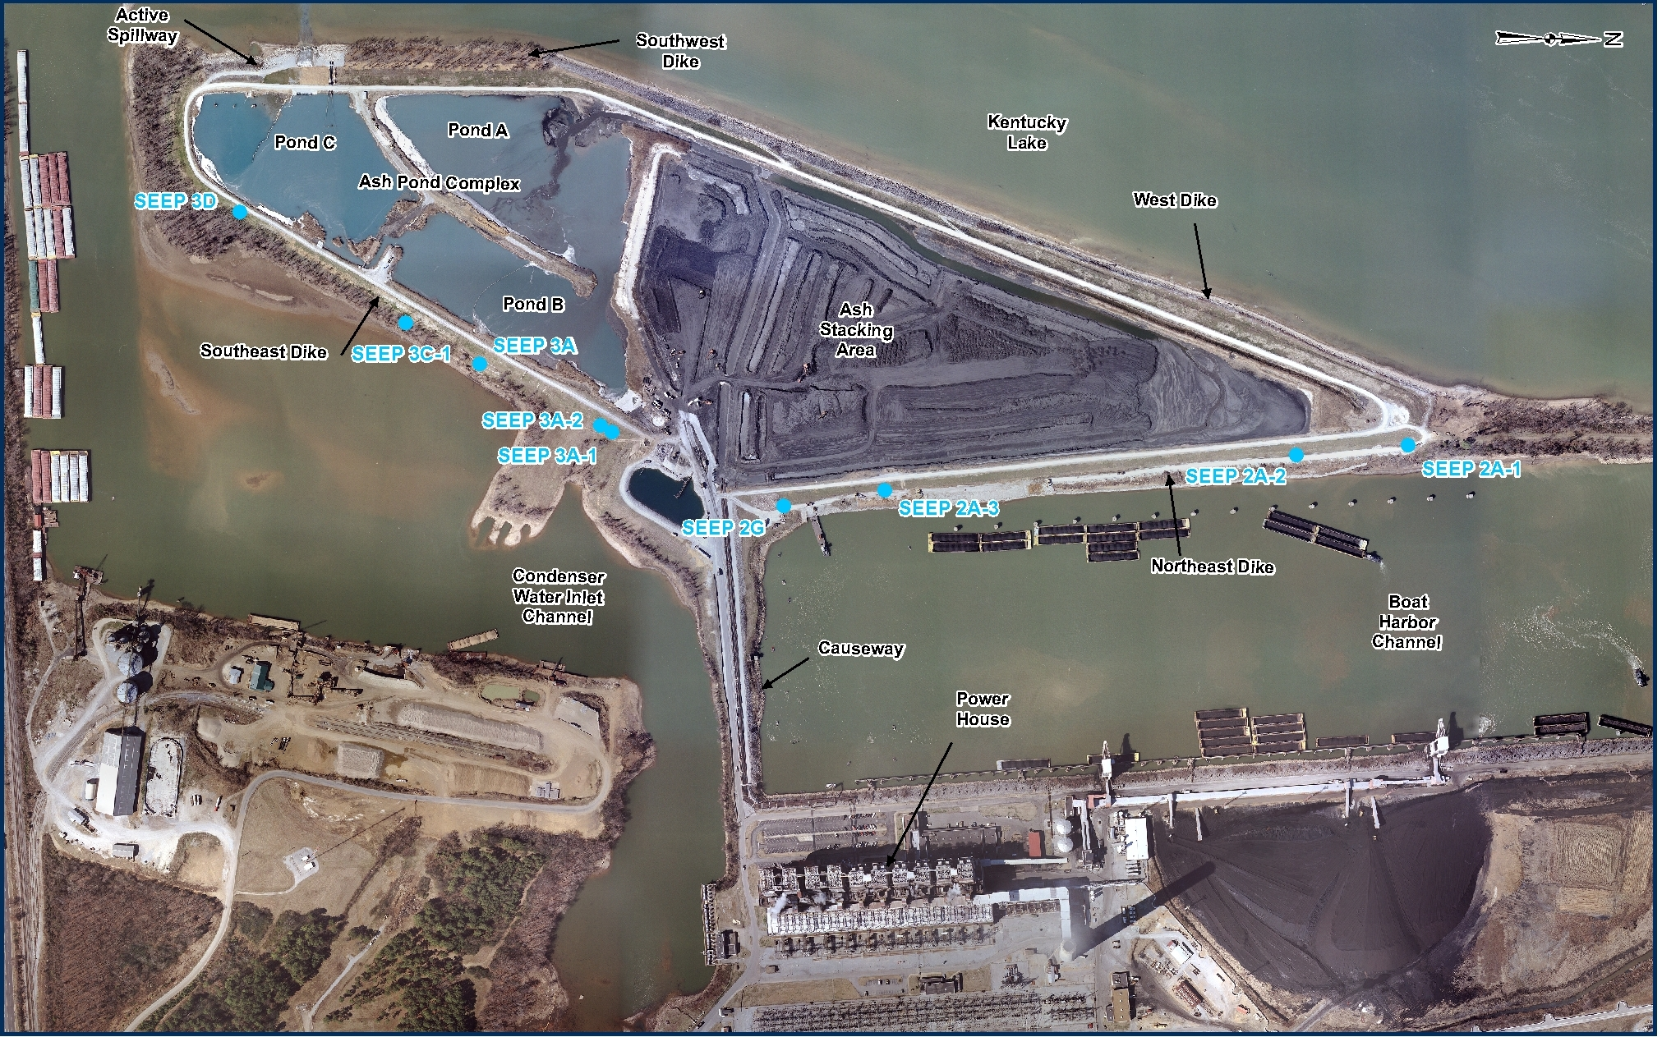
Historical Seepage Locations

Slide 26
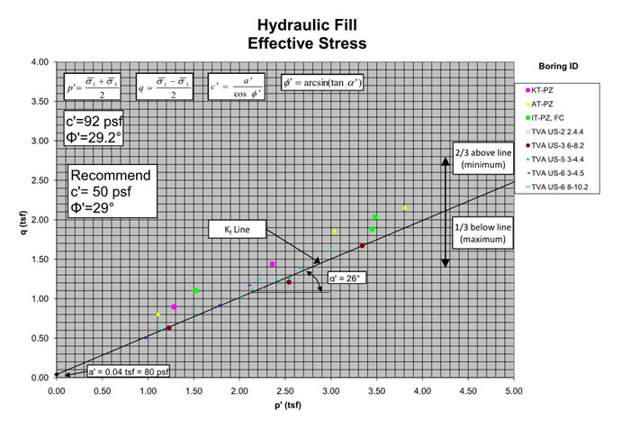
Typical Graph for Selection of
Effective Stress Shear Strength Parameters

Slide 27
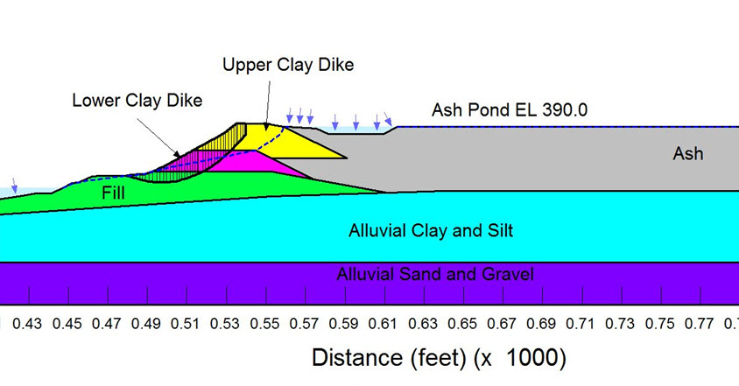
Typical SLOPE/W
Output File

Slide 28
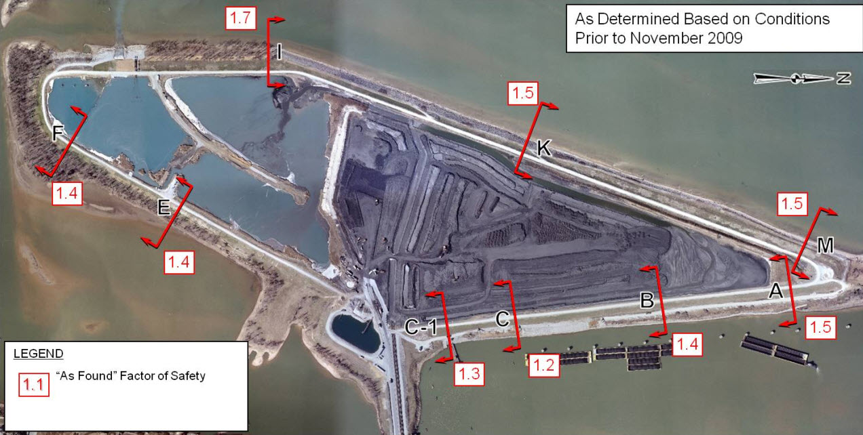
“As-Found” Slope Stability
Factors of Safety

Slide 29
Johnsonville Ash Disposal Area 2
Risk Reduction Projects
  Spillways Replacement Project (New Spillways)
  North East Dike Slope Stability Improvement Project
  Spillways Abandonment Project (Close Old Spillways)
  South East Dike Slope Stability Improvement Project
  Other Risk Reduction Projects
    Relocate Sluice Channel from Northeast Dike
    Removed 860,000 tons Ash during 2010 or approximately 1/6 of the total ash impounded at the site.
    Extended Coal Yard Drainage Basin discharge pipe by 650 feet
    Improvements to Causeway & Roadway to Island

Slide 30
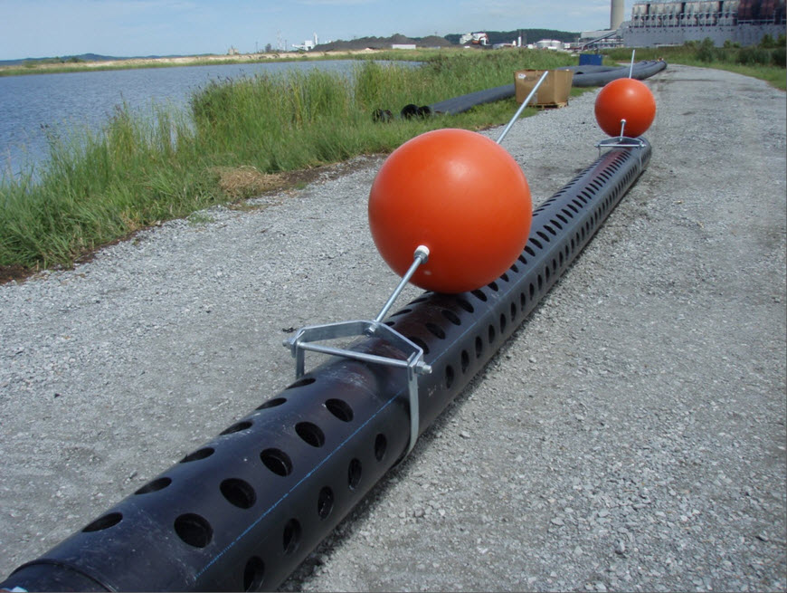
Siphon “Torpedo-Strainer” Inlet with
Float Balls Attached

Slide 31
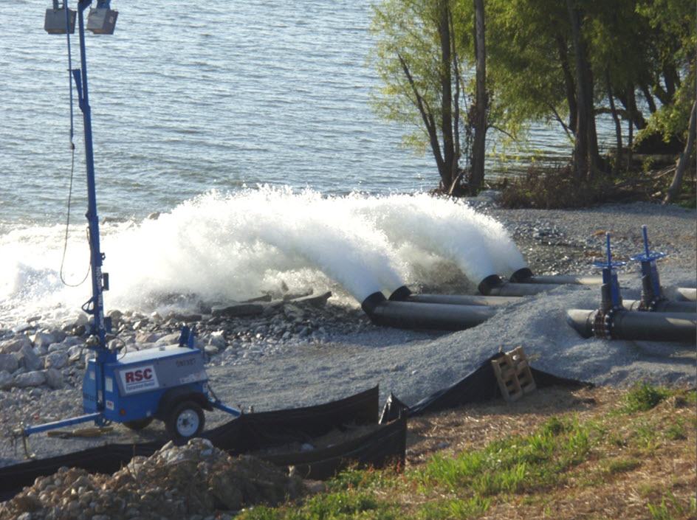
Siphons in Operation During
Pool Drawdown

Slide 32
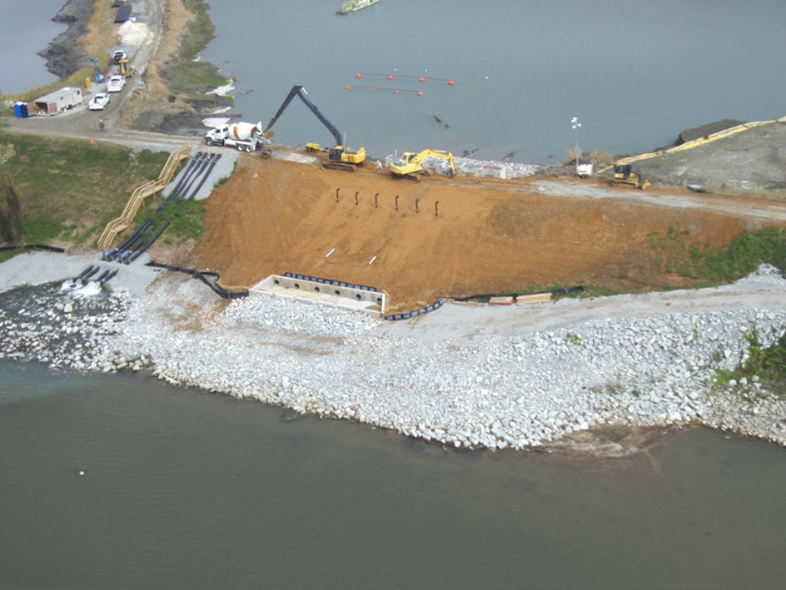
Aerial View During
Spillway Replacement Project

Slide 33
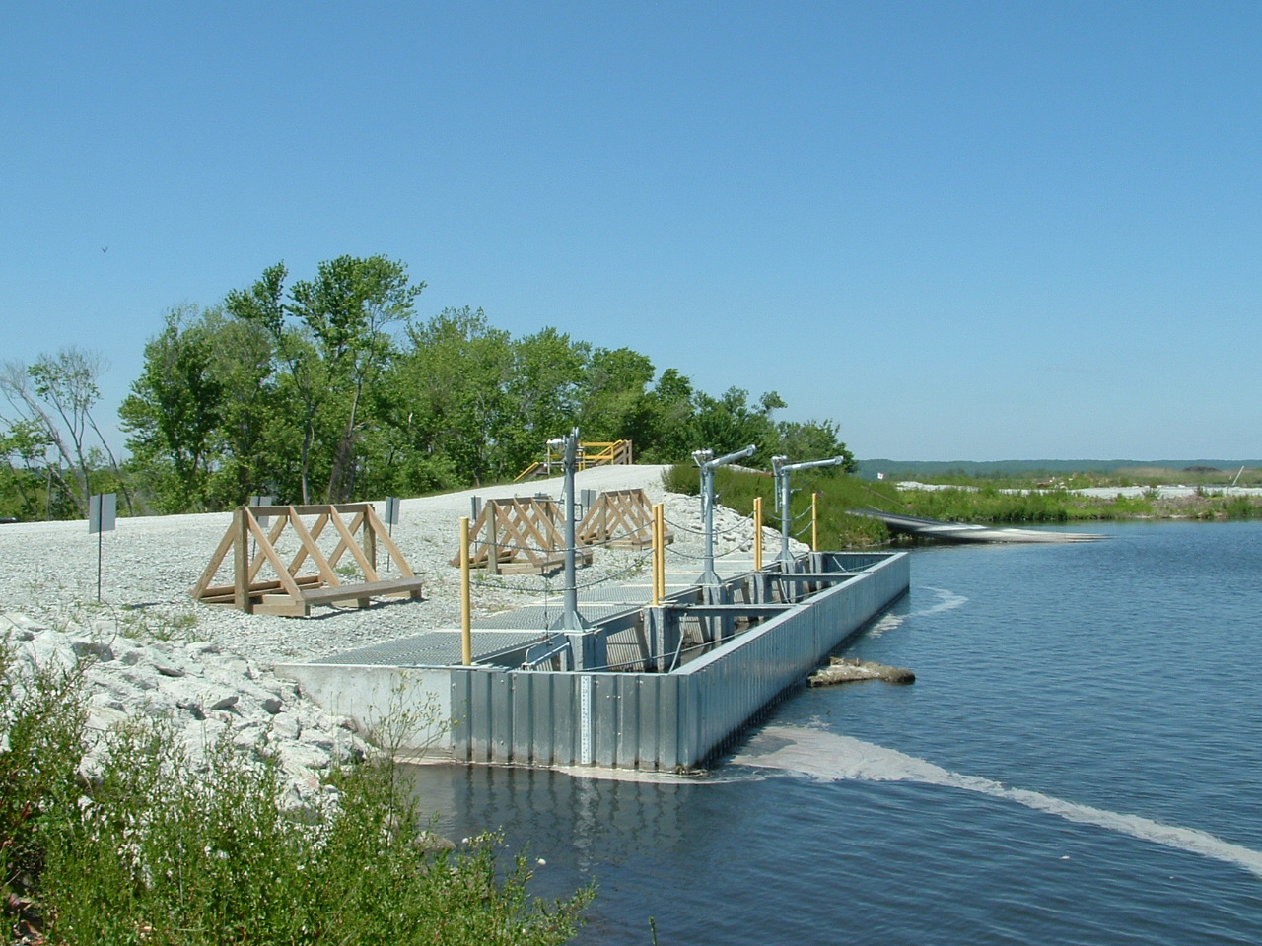
New Spillway Inlet Structures

Slide 34
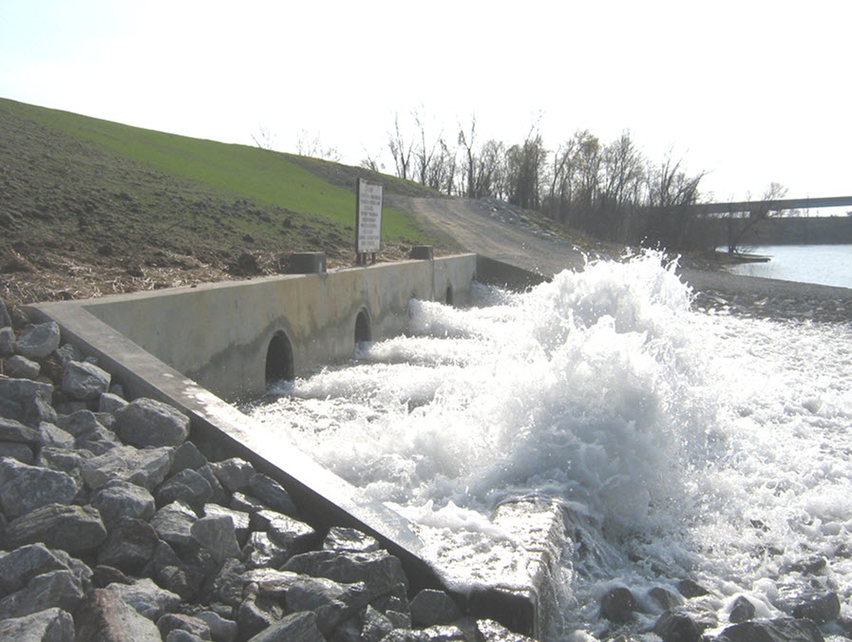
Outlet Headwall for
New Spillways

Slide 35
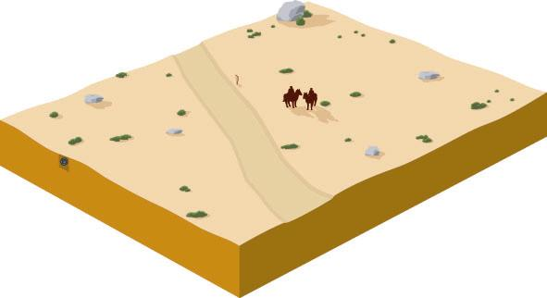





Spillways Improvements And Closures
Spillway Horizontal Pipe
Grout Mixer and Pump Truck
Spillway Riser Pipe
Dike
Ash Stilling Pond
Spillway Grouting Trench

Slide 36
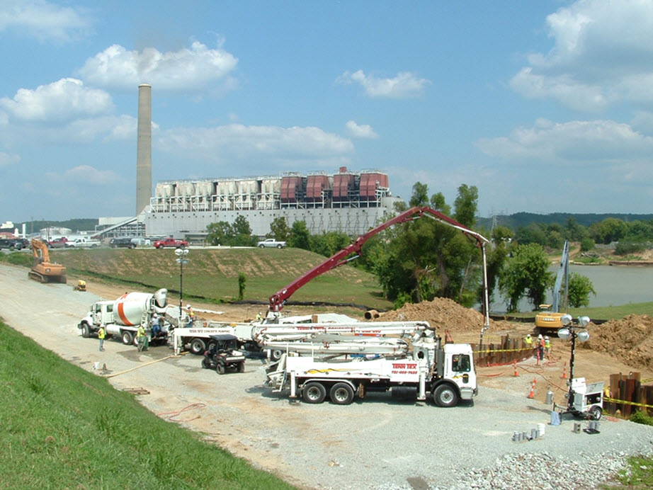
Grouting East Spillway Pipes
Spillway Closure Project

Slide 37
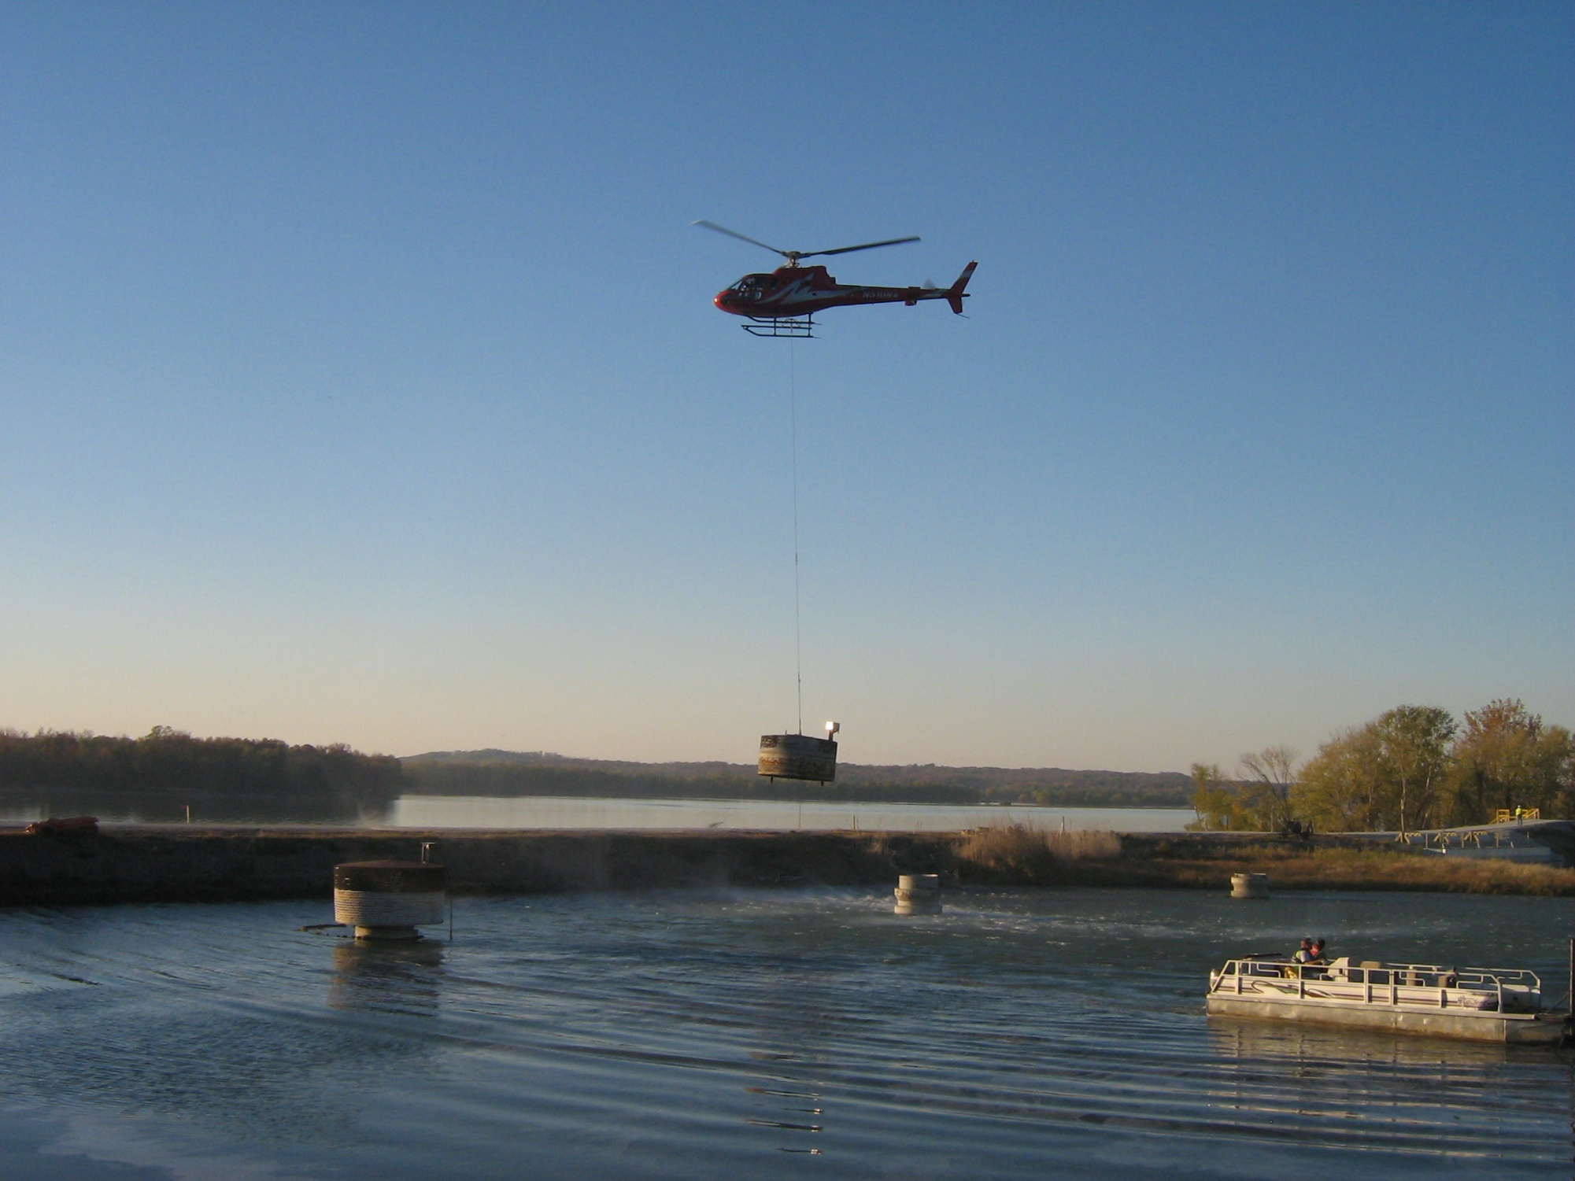
Helicopter Removing Skimmers from
South Spillway Risers

Slide 38
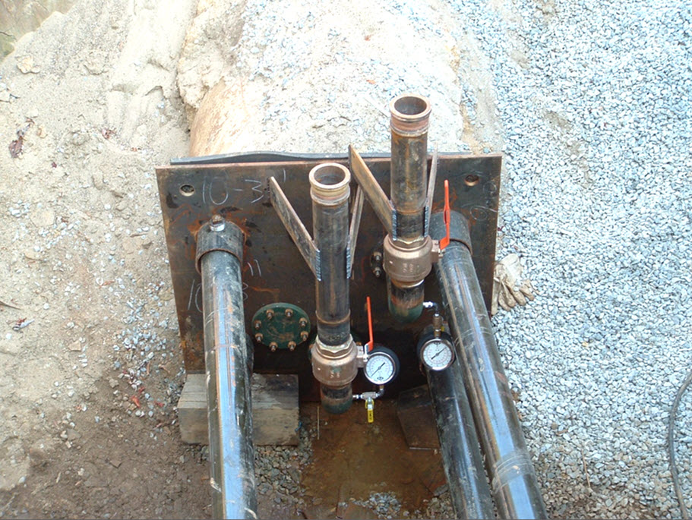
Steel Bulkheads for Grout Placement
Spillway Closure Project

Slide 39
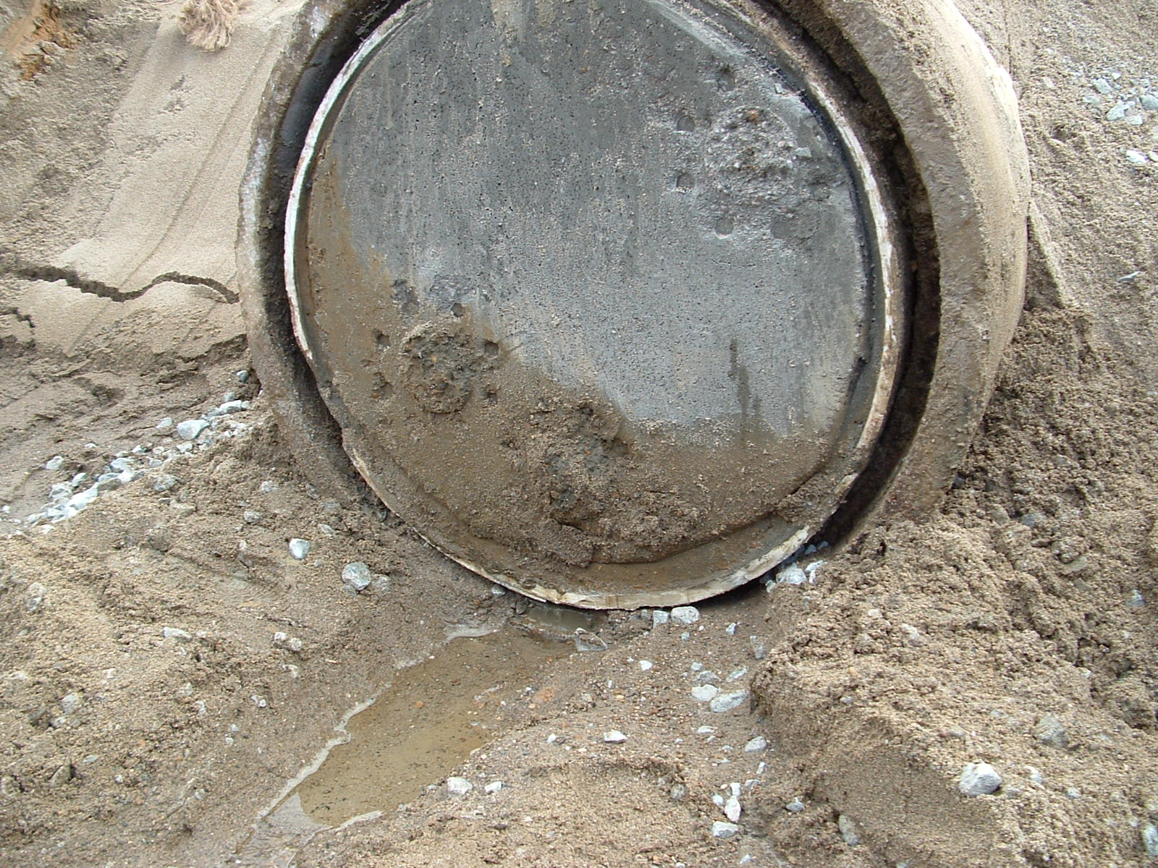
Grouting South Spillway Pipes
Spillway Closure Project

Slide 40
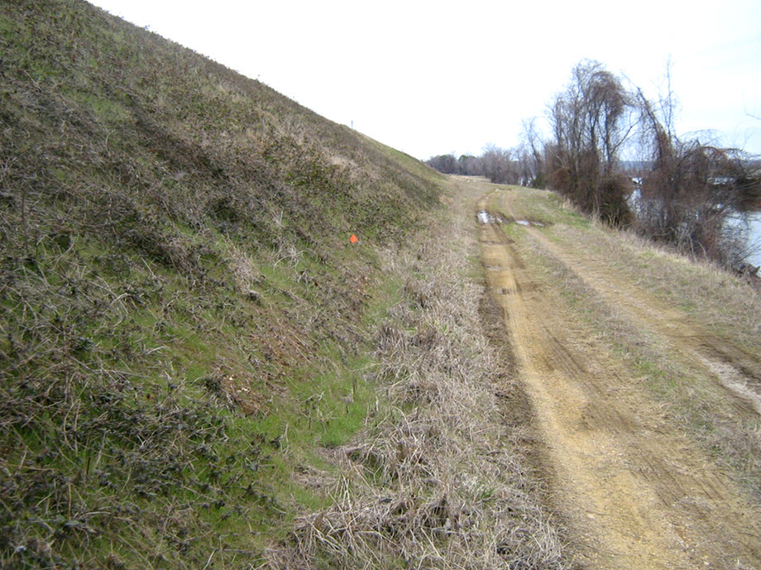
Northeast Dike Prior to
Slope Improvement Project

Slide 41
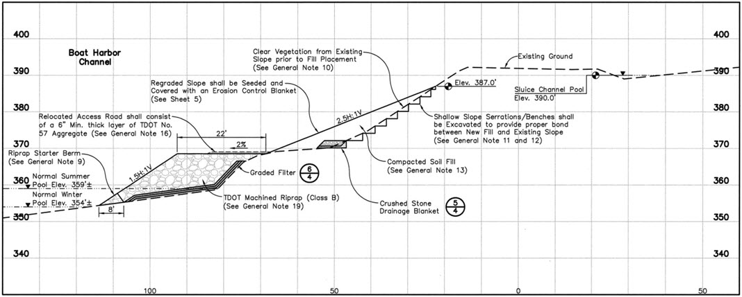
Typical Cross-Section from
Northeast Dike Slope Improvement Project

Slide 42
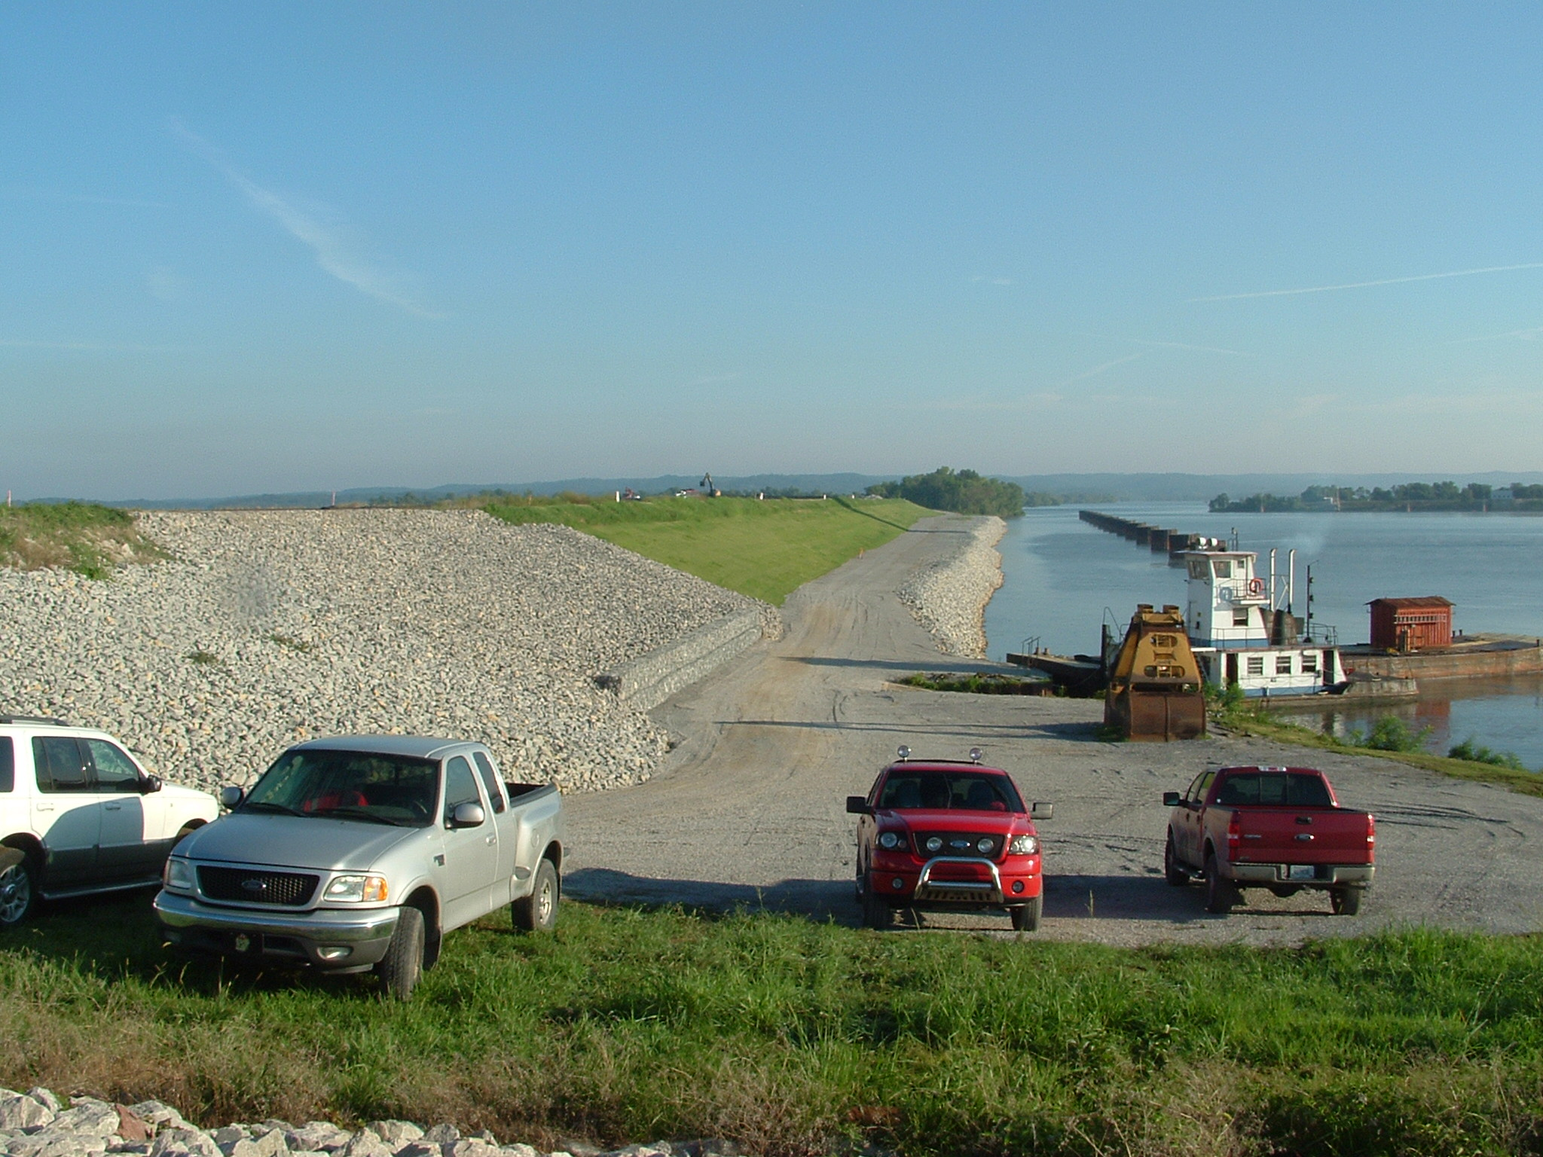
Northeast Dike Slope Improvements
Following Completion

Slide 43
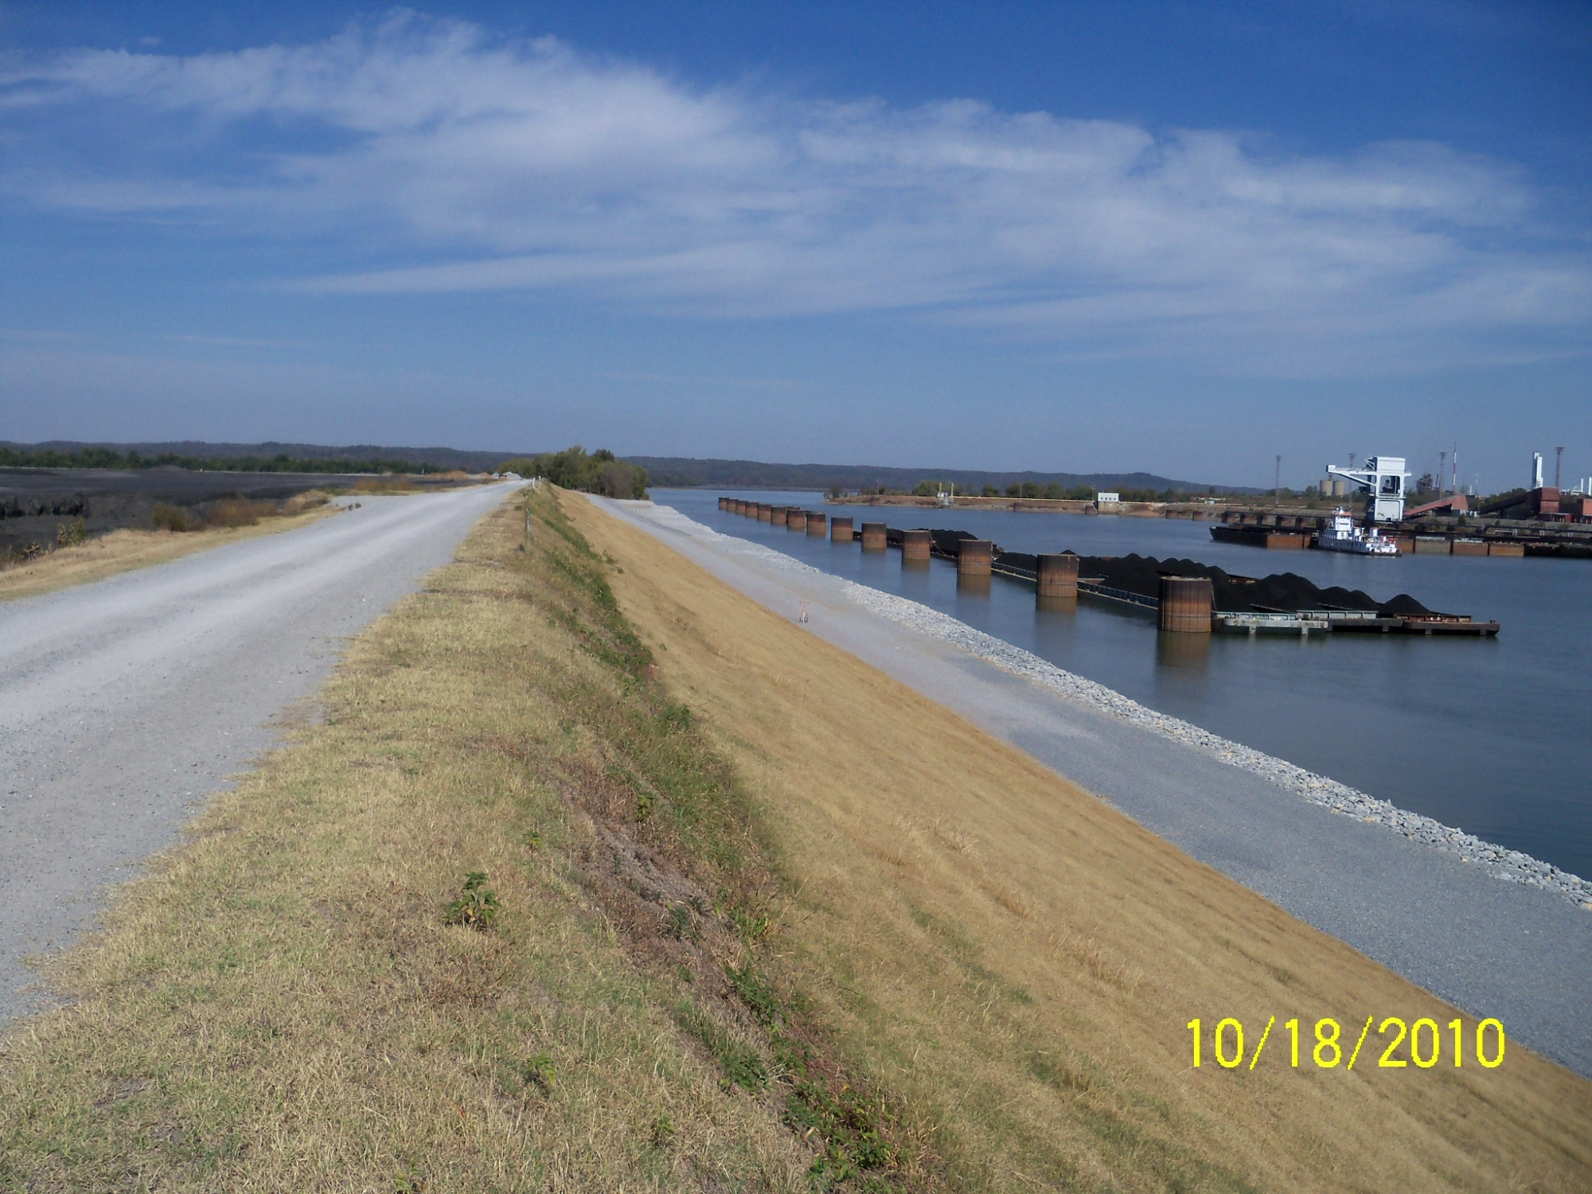
Northeast Dike Slope Improvements
Following Completion

Slide 44
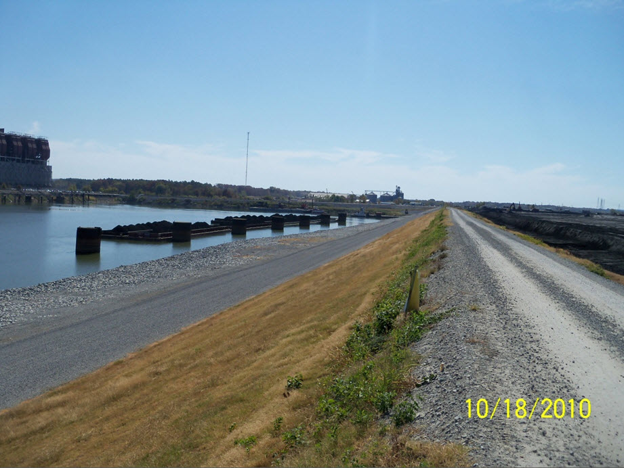
Northeast Dike Slope Improvements
Following Completion

Slide 45
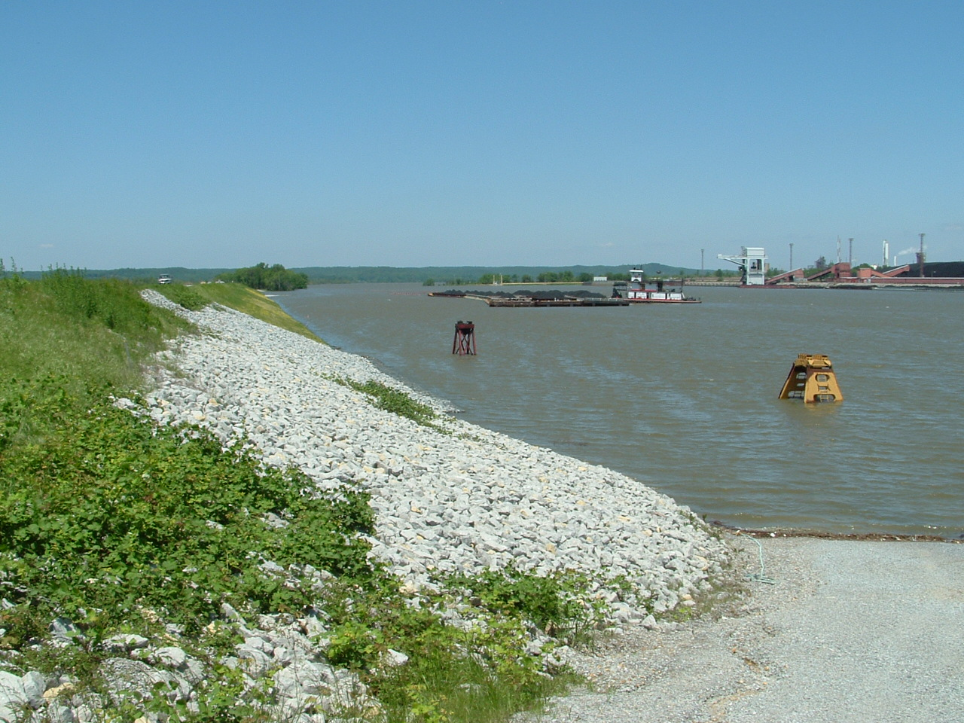
Northeast Dike Slope Improvements
During Record KY Lake Pool Level

Slide 46
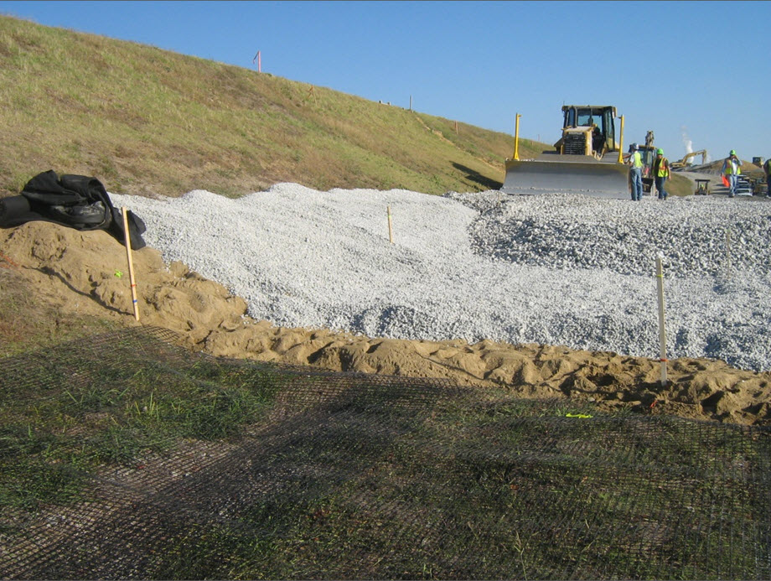
Graded Filter Construction at Seep 3A
Southeast Dike Slope Improvements

Slide 47
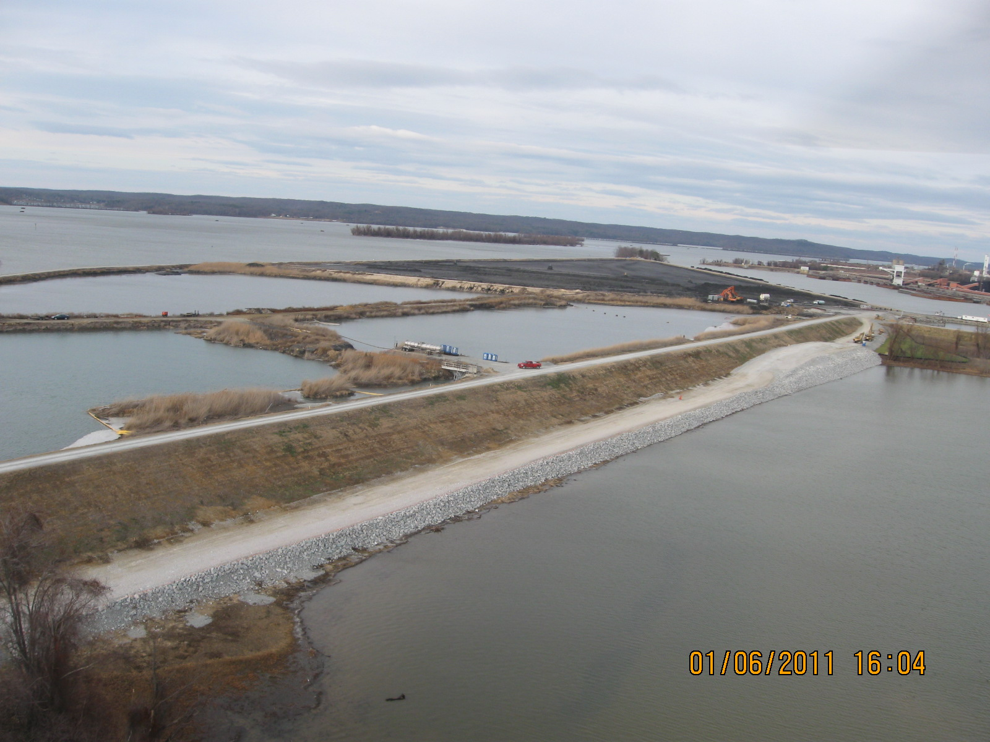
Southeast Dike Slope Improvements
During Construction

Slide 48
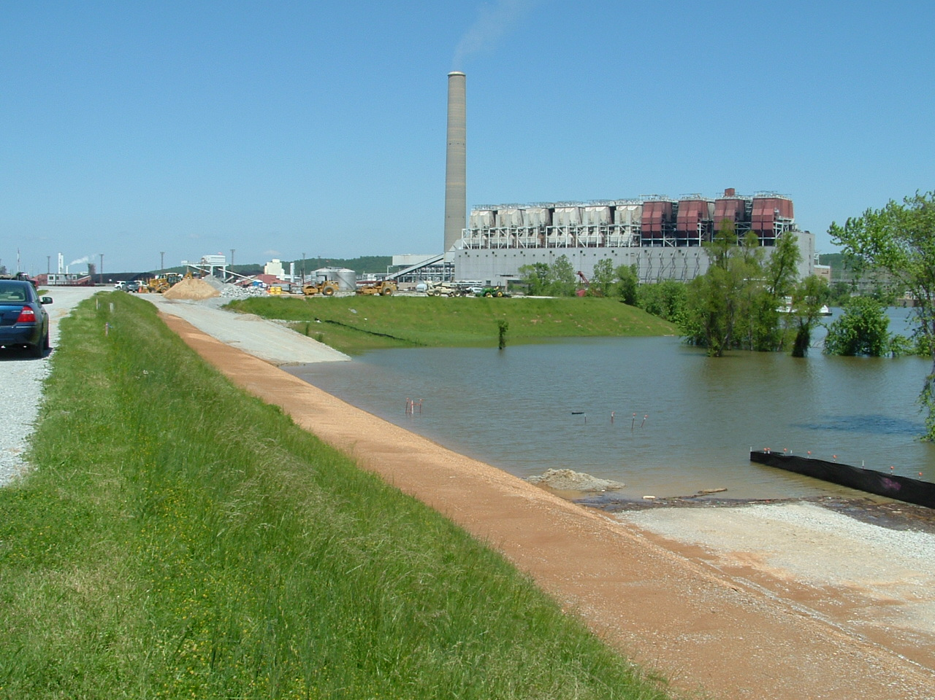
Southeast Dike Slope Improvements
During Record KY Lake Pool Level

Slide 49
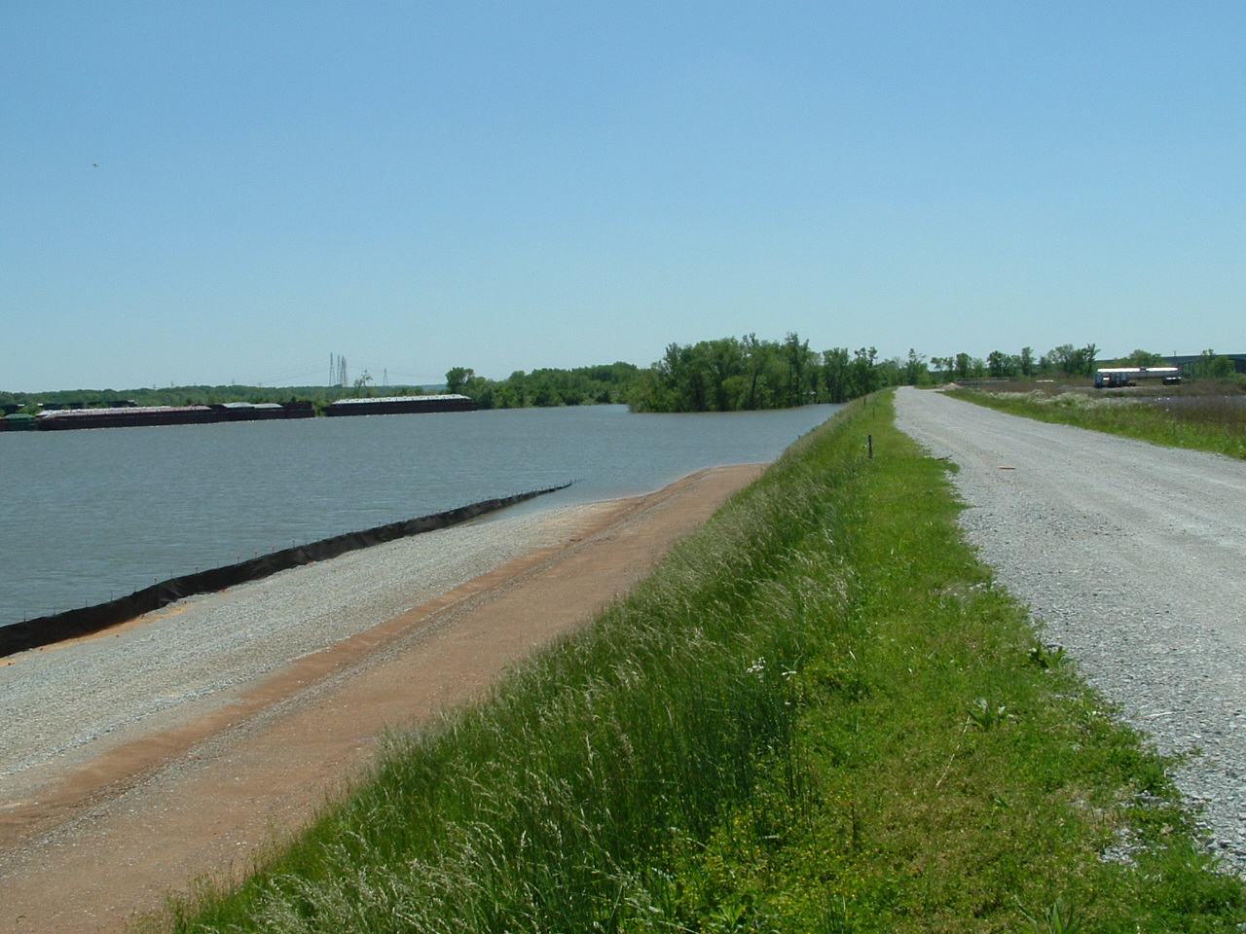
Southeast Dike Slope Improvements
During Record KY Lake Pool Level

Slide 50
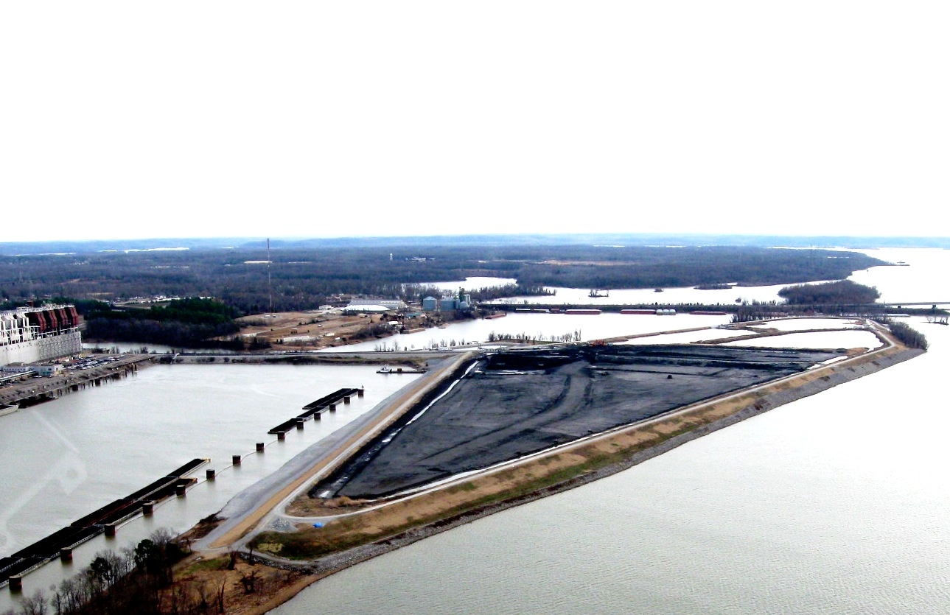
Routine Handling, Operations & Maintenance
Improvements
    Removed 860,000 tons Ash during 2010 or approximately 1/6 of the total ash impounded at the site.

Slide 51
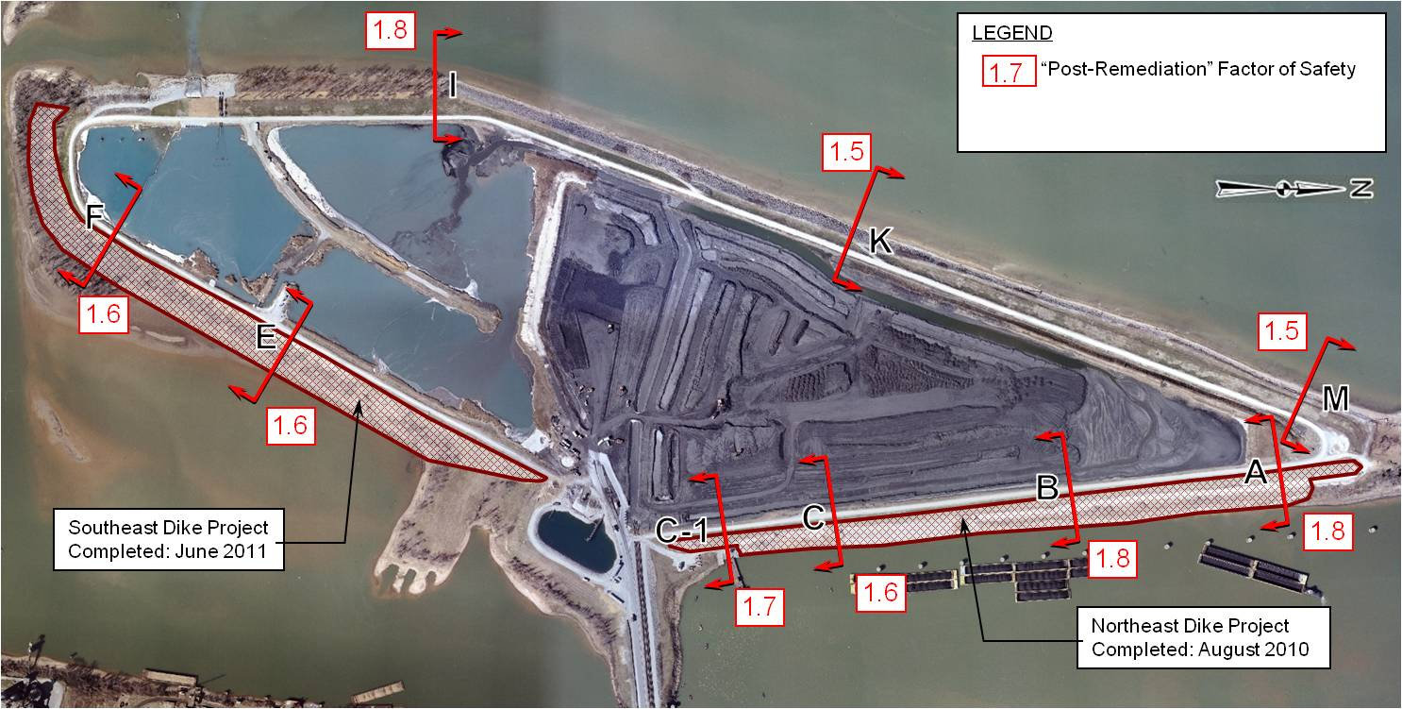
“Post-Remediation” Slope Stability
Factors of Safety

Slide 52
Johnsonville Ash Disposal Area 2
Summary & Conclusions
  In early 2009, TVA began an aggressive risk reduction program that included:
    Phase 1 Assessments
    Phase 2 Studies (Geotechnical/Hydraulics & Hydrology)
    Improvements to Routine Handling , Maintenance & Operations
    Capital Improvement Projects
    Hazard Classifications, Dam Safety Training, etc.;
  The JOF Risk Reduction Program for Ash Disposal Area No. 2 is the first to be completed :
    Addressed all freeboard and spillway concerns;
    Addressed all slope instability and areas with seepage issues;
    Removed excess stockpiled ash and dried out the northern half of the island;
    Improved mowing and vegetation removal, elimination of animal burrows

Slide 53
Johnsonville Ash Disposal Area 2
Summary & Conclusions
  Highlights achieved at JOF:
    Attained Tennessee State Dam Safety Program for an existing Significant Hazard structure;
    Completed design and capital improvements on timely and cost efficient manner.
    All works were done safely while facility maintained its fully operational status;
    No environmental permit violations or issues;
    No reportable safety incidents.
    Well-documented “Lessons Learned” for future Risk Reduction projects at other TVA facilities.
    All this while having lots of fun along the way.

Slide 54
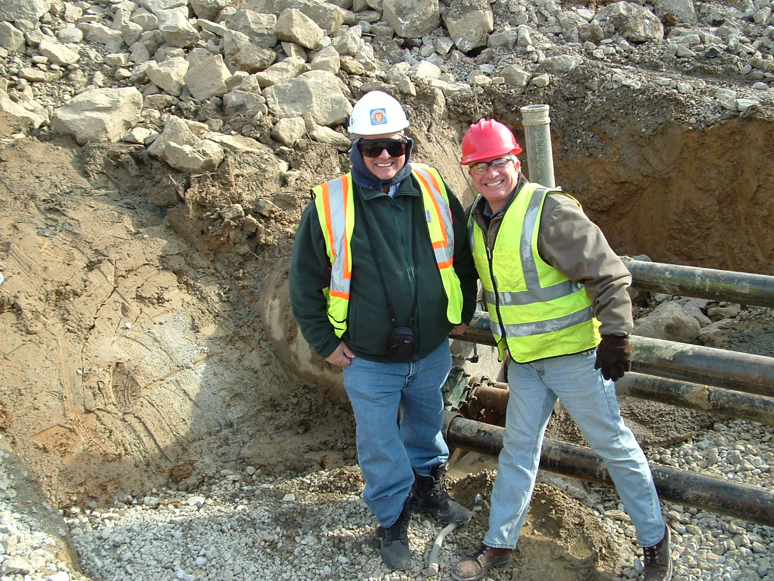
Clowns in the Trench
We hope you enjoyed our presentation ! Any Questions?
I hope that they don’t ask any questions about PPD!

